Slide 1

Analyze Challenges in Image Sensing Systems
ITA0505 – COMPUTER VISION
GUIDED BY:
Dr. P. Lourdu Mahimai Doss
PRESENTED BY:
P. KALYAN (192525212)
K. MANOJ KUMAR(192521041)
KRISH GIRIDHARAN(192511322)
NATESA KRISHNAN V(192511311)

Slide 2


Introduction
What is an Image Sensing System?
An image sensing system captures real-world scenes and converts them into digital images for processing.
Components
Light Source
Object
Lens
Image Sensor (CCD/CMOS)
Analog-to-Digital Converter (ADC)
Digital Image
Applications
Medical Imaging
Satellite Imaging
Security Surveillance
Autonomous Vehicles
Smartphones

Slide 3
ADVANTAGES
Improves overall image quality and reduces noise and blur in captured images.
Enhances image contrast and brightness and minimizes acquisition-related errors.
Increases accuracy of image analysis and supports real-time image processing.
Provides reliable performance under varying lighting conditions.
Improves object detection and recognition.
Cost-effective by enhancing images through software techniques.
Applicable in medical imaging, surveillance, satellite imaging, and autonomous vehicles.

Slide 4
DISADVANTAGES
Requires high computational power for advanced image processing,processing time may increase for high-resolution images.
Performance depends on the quality of the image sensor.
Image enhancement cannot fully recover severely degraded images.
AI-based techniques require large datasets for training.
Increased system complexity due to multiple processing stages.
High-quality sensors and hardware can be expensive.
Sensitive to extreme lighting and environmental conditions.
Requires regular calibration and maintenance for accurate results.
Large image datasets demand higher storage and memory.

Slide 5
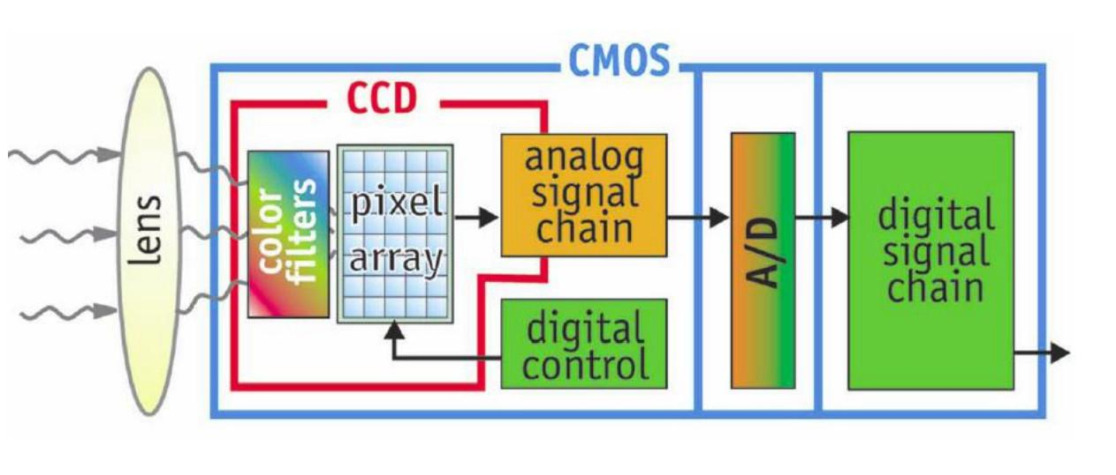
Image Acquisition Process
How an Image is Acquired
steps:
Scene illumination
Lens focuses light
Sensor captures photons
Electrical signal generation
Analog-to-Digital Conversion
Digital image formation
Key Point
The quality of the final image depends on every stage of acquisition.

Slide 6
Challenges in Image Sensing Systems
Acquisition-Related Problems:
Sensor Noise
Random unwanted signals reduce image quality.
Motion Blur
Occurs due to camera or object movement.
Poor Illumination
Low light results in dark and noisy images.
Sampling Errors
Insufficient sampling causes aliasing.
Quantization Errors
Loss of image details during digitization.
Lens Distortion
Images become geometrically distorted.

Slide 7
Problem Analysis
Causes and Effects
Problem | Cause | Effect
Noise | Sensor electronics | Grainy image
Blur | Camera motion | Loss of sharpness
Poor lighting | Insufficient illumination | Low visibility
Aliasing | Low sampling rate | Jagged edges
Quantization | Low bit depth | Loss of detail
Lens distortion | Optical imperfections | Warped image
Observation: Each acquisition problem directly reduces image quality and affects further processing..

Slide 8
Analytical Methods
Image Quality Evaluation Techniques:
Histogram Analysis
Measures brightness distribution.
Signal-to-Noise Ratio (SNR)
Evaluates signal strength relative to noise.
Peak Signal-to-Noise Ratio (PSNR)
Measures image reconstruction quality.
Mean Square Error (MSE)
Calculates error between original and processed images.
Structural Similarity Index (SSIM)
Measures perceived image similarity.

Slide 9
Proposed Solution
Proposed Image Enhancement Framework
The proposed system addresses acquisition-related challenges using image enhancement and quality assessment techniques.
Techniques Used
Noise Reduction (Median/Gaussian Filter)
Contrast Enhancement (Histogram Equalization)
Image Sharpening
Sensor Calibration
Edge Enhancement
AI-based Image Restoration
Benefits
Better image clarity
Reduced acquisition errors
Improved feature extraction
Enhanced object detection

Slide 10
Applications and Future Scope
Applications
Medical Diagnosis
Autonomous Vehicles
Security Surveillance
Remote Sensing
Industrial Inspection
Agriculture
Face Recognition
Smart Cities
Future Scope
AI-assisted image sensing
Quantum image sensors
Event-based cameras
Edge AI processing
3D imaging
HDR imaging
Hyperspectral imaging

Slide 11
Conclusion
Image sensing systems play a vital role in modern technology.
Image acquisition quality directly affects analysis accuracy.
Challenges such as noise, blur, poor illumination, and sampling errors must be addressed.
Analytical methods like Histogram Analysis, SNR, PSNR, MSE, and SSIM help evaluate image quality.
Image enhancement techniques and AI-based approaches significantly improve image acquisition performance.

Slide 12
THANK YOU

